Slide 1

Sprocket Central Pty Ltd
Data analytics approach
[Division Name] - [Engagement Manager], [Senior Consultant], [Junior Consultant]

Slide 2
Agenda
Introduction
Data Exploration
Model Development
Interpretation

Slide 3
Introduction
Approaches and main insight for new customers:
Age distribution
Gender
States Population
Job Industries

Slide 4
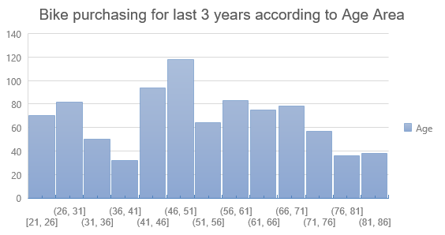
Data Exploration
1. What is the age range for the bike purchasers?
Data shows that most new customers at the age range of (45 and 51)
Fewer customer age group in range (36 – 41) and (76 - 81)

Slide 5
Data Exploration
2. Which gender of customers is most frequently represented?
Data shows that females are more than males in purchasing.
The target audience for our marketing and advertising should be inclined to provide focus on females than males.

Slide 6
Data Exploration
3. Which state has most customers ?
New South Wales has most new customers with 506 customers.
Queensland has less customer.

Slide 7
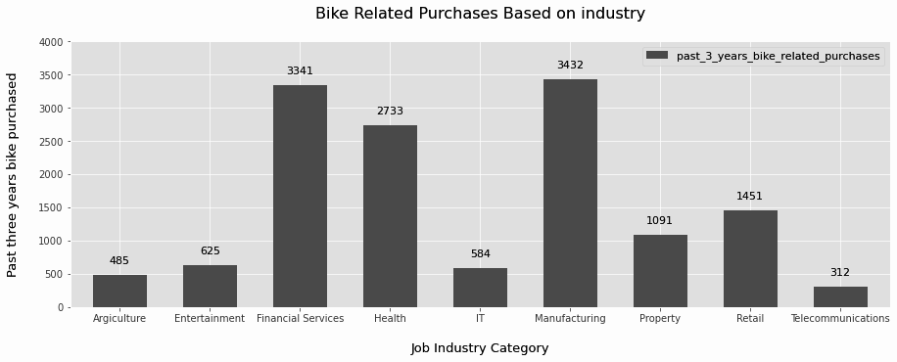
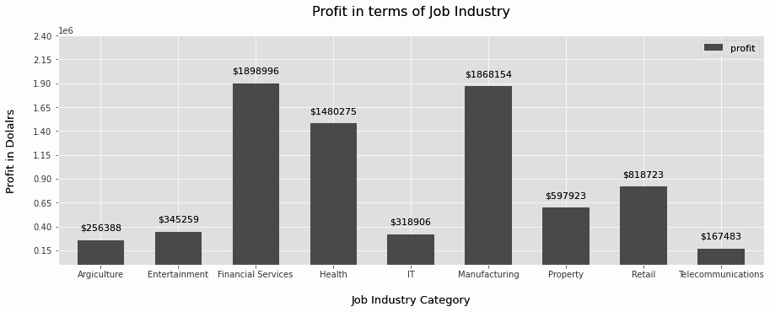
Data Exploration
4. Which Job Industries is most frequently represented?
Financial Services, Manufacturing, and Health are the top three profit-generating industries, followed by retail and property.
The highest profits are also Financial Services, Manufacturing, and Health as seen in the second chart.

Slide 8
Model Development
Customer Classifications – Targeting High Value Customers
It is better to consider the following points for the high value clients :
Aged between 40 – 50.
Most of the high value customers are female compared to male.
Working in Financial Service, Manufacturing and Health.
Who are currently living in New South Wales and Victoria.

Slide 9
Interpretation
Table of high value customer summary:
Customer ID | Bike related purchases last 3 years | Age | Job Industy | Wealth Segmet | Owns Cars | State
1842 | 445 | 44 | Financial Services | Mass Customer | No | NSW
2001 | 168 | 44 | Manufacturing | Mass Customer | Yes | NSW
650 | 486 | 44 | Health | Mass Customer | No | NSW
3297 | 234 | 46 | Manufacturing | Mass Customer | No | VIC
50 | 266 | 41 | Manufacturing | Mass Customer | Yes | NSW

Slide 10
THANKS

